Slide 1
AMAZON SALES
DATA ANALYSIS
ATHARV S JOSHI

Slide 2
Problem Statement
Objective
Benefits
Help out to make better business decisions.
Help analyze customer trends and satisfaction, which can lead to new and better products and services.
Gives better insight of customers base.
Helps in easy flow for managing resources.
Sales management has gained importance to meet increasing competition and the need
for improved methods of distribution to reduce cost and to increase profits. Sales
management today is the most important function in a commercial and business
enterprise.
Develop a Report by Extracting-Transforming-Loading of data which contains Sales trend with respect to Year, Month, Quarter and find Some relationships through data to understand and Analyze the Facts.

Slide 3
Quick Insight
﻿A quick insight for 2021 | 2022 | amazon sales.
181.6M
Total Sales
2857K
Sales Quantity
75.45M
Total Profit
639
Products
439
Customers

Slide 4
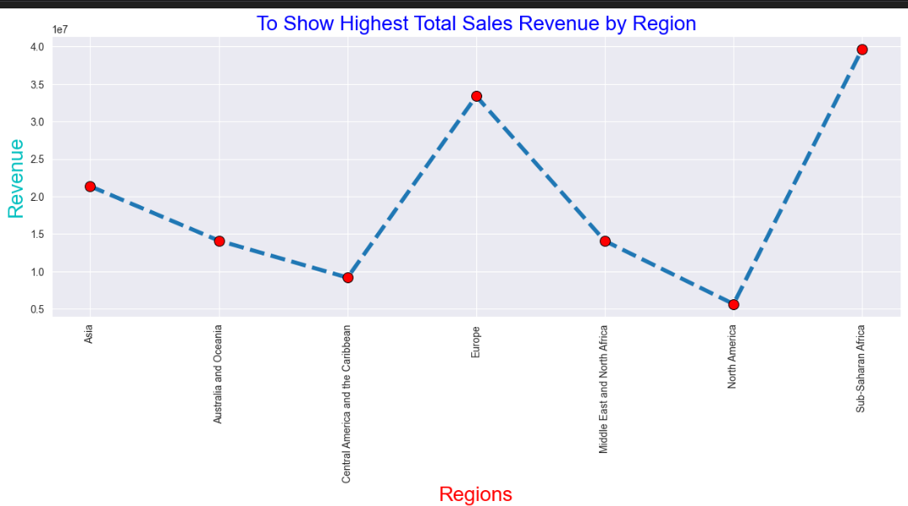

Slide 5
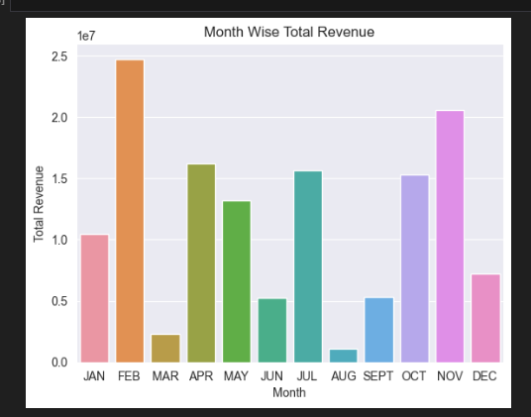
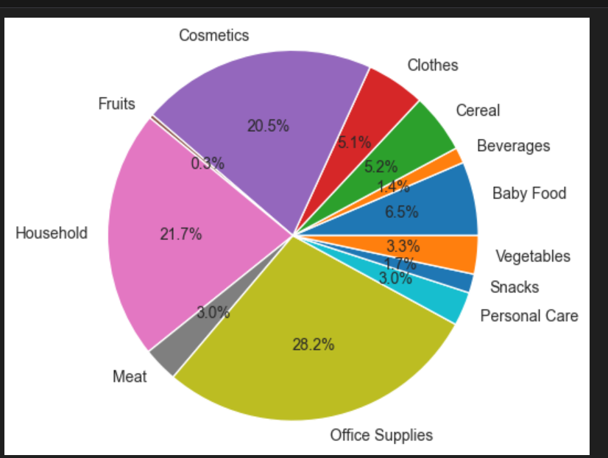

Slide 6
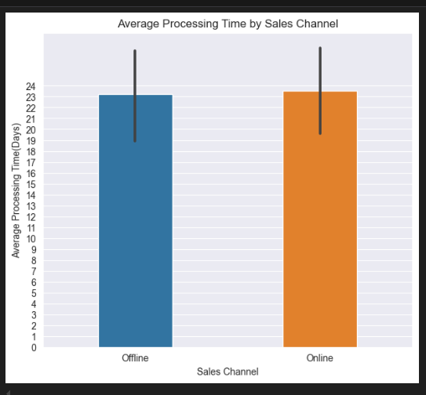
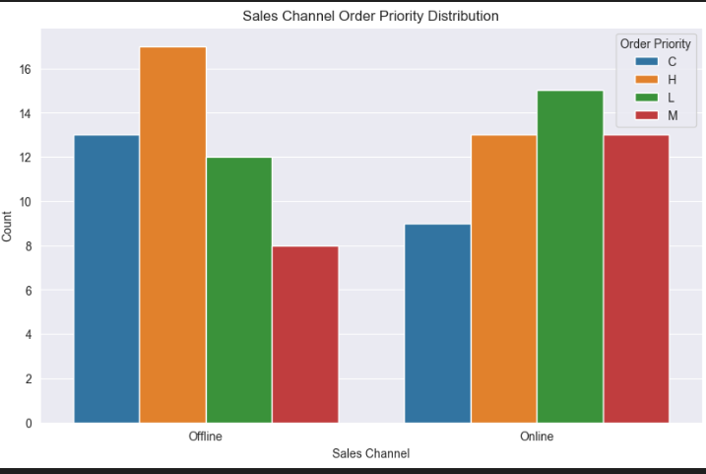

Slide 7
Conclusion
The Amazon sales analysis provided important insights into the company’s performance and customer behavior AND which helps in planning marketing strategies and managing inventory. The analysis identified top-selling categories and products, showing what customers prefer. This information can guide future product development and marketing efforts. Additionally, the breakdown of revenue sources revealed which products contribute most to sales, helping Amazon allocate resources more efficiently. Overall, the analysis offers a clear understanding of Amazon’s sales trends, customer preferences, and revenue drivers, allowing for better business decisions and growth strategies. Overall Sales through Online and Offline Channel.

Slide 8
Thank You

